Slide 1

ONLINE CLASS
GRAPH THEORY
BICTE $6^{TH}$ SEMESTER
2078/03/02
PRESENTED BY KALYAN DAHAL

Slide 2
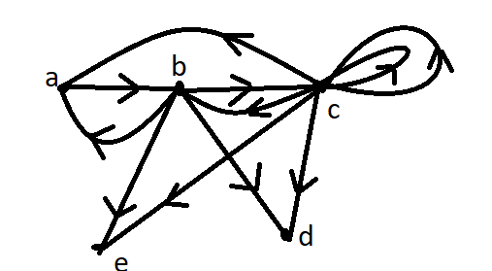
calculate the in-degree and out-degree of each vertex in the given digraph.
The out-degree and in-degree of vertex of given figure as below:
vertex | a | b | c | d | e
Out-degree | 1 | 4 | 6 | 0 | 0
In-degree | 2 | 2 | 3 | 2 | 2

Slide 3
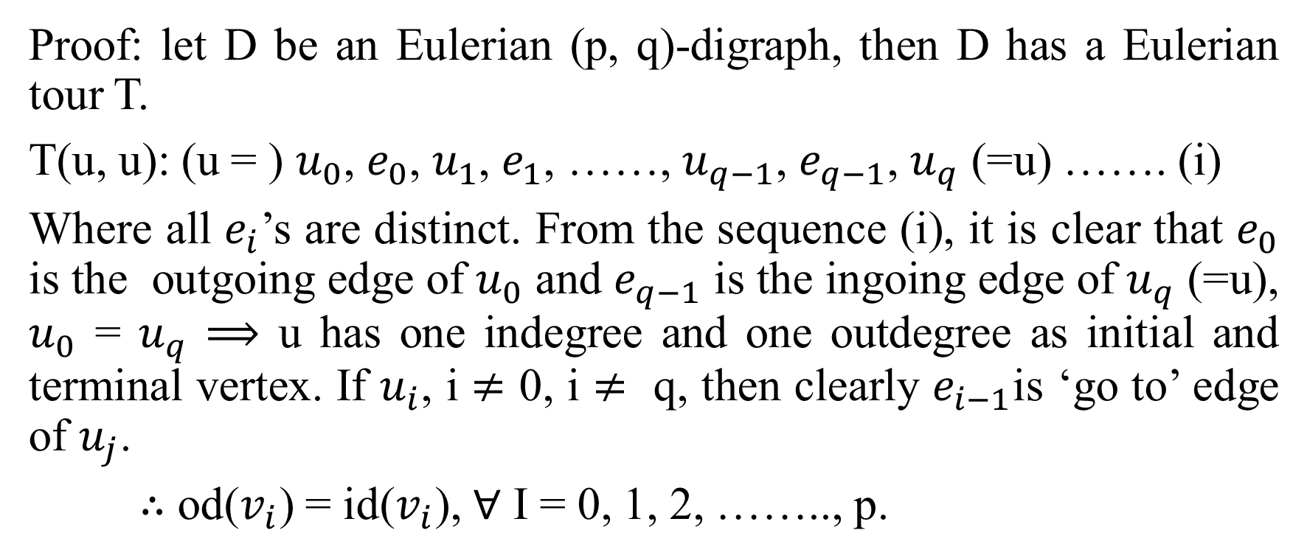
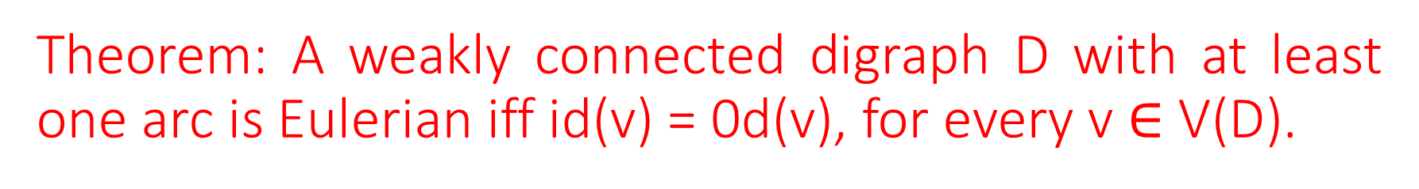
Theorem: A weakly connected digraph D with at least one arc is Eulerian iff id(v) = 0d(v), for every v $∈$ V(D).
Proof: let D be an Eulerian (p, q)-digraph, then D has a Eulerian tour T.
T(u, u): (u = ) $u_{0}$, $e_{0}$, $u_{1}$, $e_{1}$, ……, $u_{q−1}$, $e_{q−1}$, $u_{q}$ (=u) ……. (i)
Where all $e_{i}$’s are distinct. From the sequence (i), it is clear that $e_{0}$ is the outgoing edge of $u_{0}$ and $e_{q−1}$ is the ingoing edge of $u_{q}$ (=u), $u_{0}$ = $u_{q}$ $⟹$ u has one indegree and one outdegree as initial and terminal vertex. If $u_{i}$, i $≠$ 0, i $≠$ q, then clearly $e_{i−1}$is ‘go to’ edge of $u_{j}$.
$∴$ od($v_{i}$) = id($v_{i}$), $∀$ I = 0, 1, 2, …….., p.

Slide 4
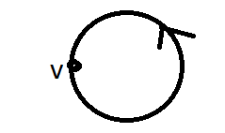
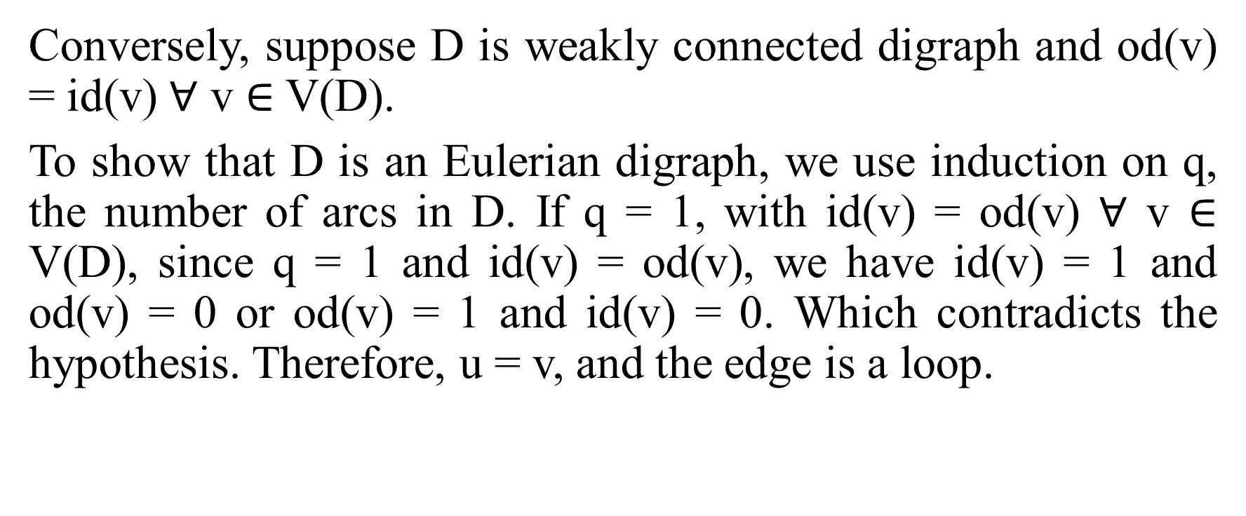
Continued….
Conversely, suppose D is weakly connected digraph and od(v) = id(v) $∀$ v $∈$ V(D).
To show that D is an Eulerian digraph, we use induction on q, the number of arcs in D. If q = 1, with id(v) = od(v) $∀$ v $∈$ V(D), since q = 1 and id(v) = od(v), we have id(v) = 1 and od(v) = 0 or od(v) = 1 and id(v) = 0. Which contradicts the hypothesis. Therefore, u = v, and the edge is a loop.

Slide 5
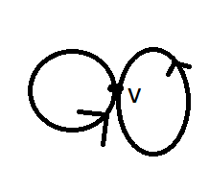
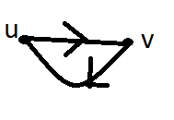
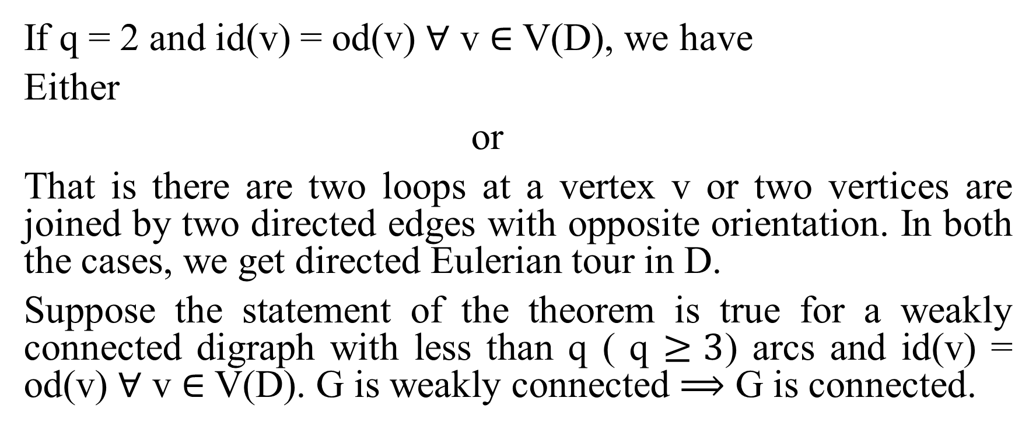
Continued….
If q = 2 and id(v) = od(v) $∀$ v $∈$ V(D), we have
Either
or
That is there are two loops at a vertex v or two vertices are joined by two directed edges with opposite orientation. In both the cases, we get directed Eulerian tour in D.
Suppose the statement of the theorem is true for a weakly connected digraph with less than q ( q $≥3$) arcs and id(v) = od(v) $∀$ v $∈$ V(D). G is weakly connected $⟹$ G is connected.

Slide 6
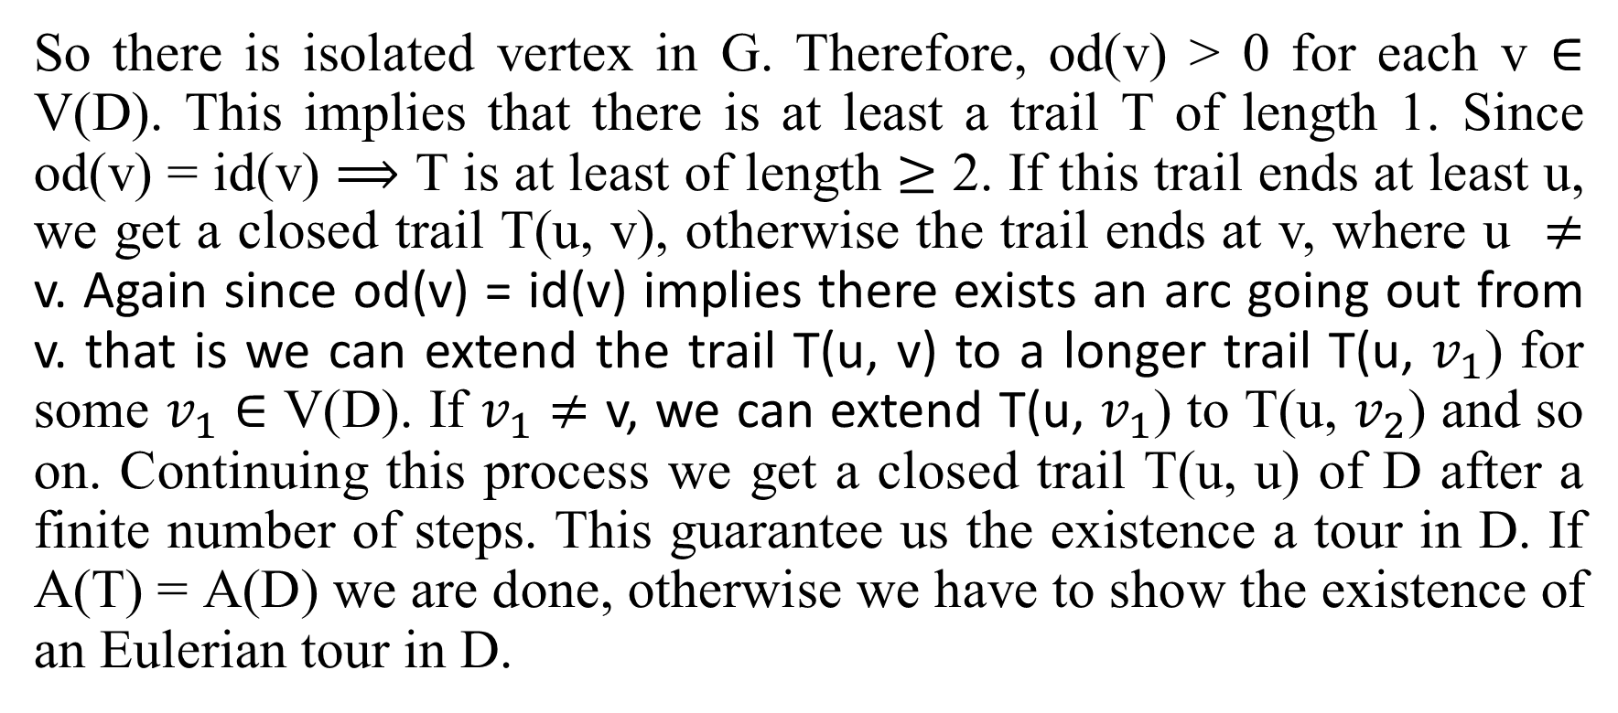
Continued…..
So there is isolated vertex in G. Therefore, od(v) > 0 for each v $∈$ V(D). This implies that there is at least a trail T of length 1. Since od(v) = id(v) $⟹$ T is at least of length $≥$ 2. If this trail ends at least u, we get a closed trail T(u, v), otherwise the trail ends at v, where u $≠$ v. Again since od(v) = id(v) implies there exists an arc going out from v. that is we can extend the trail T(u, v) to a longer trail T(u, $v_{1}$) for some $v_{1}$ $∈$ V(D). If $v_{1}$ $≠$ v, we can extend T(u, $v_{1}$) to T(u, $v_{2}$) and so on. Continuing this process we get a closed trail T(u, u) of D after a finite number of steps. This guarantee us the existence a tour in D. If A(T) = A(D) we are done, otherwise we have to show the existence of an Eulerian tour in D.

Slide 7
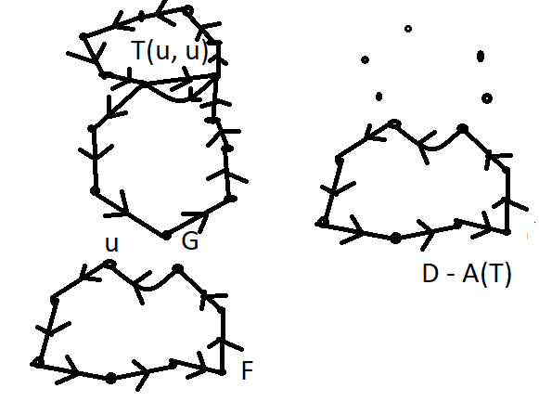
Continued…..
Let us construct a direct subgraph T of D. Let G = D – A(T) and K be the set of isolated vertices of the subgraph D – A(T) and let F = G – K . By our construction

Slide 8
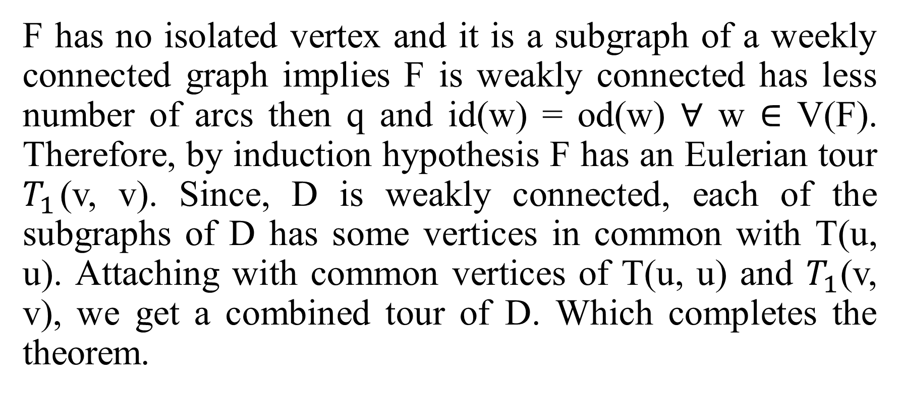
Continued…..
F has no isolated vertex and it is a subgraph of a weekly connected graph implies F is weakly connected has less number of arcs then q and id(w) = od(w) $∀$ w $∈$ V(F). Therefore, by induction hypothesis F has an Eulerian tour $T_{1}$(v, v). Since, D is weakly connected, each of the subgraphs of D has some vertices in common with T(u, u). Attaching with common vertices of T(u, u) and $T_{1}$(v, v), we get a combined tour of D. Which completes the theorem.

Slide 9
Theorem: A weakly connected digraph D with at least two vertices has a directed open Eulerian trail iff D has two vertices u and v such that od(u) = id(u) + 1 and id(v) = od(v) + 1, for all other vertices W of D, id(w) = od(w). Furthermore, in this case, the trail begins at u and ends at v.
Proof: Let an Euler trail T in D such that T begins at u and ends at v. Different than u and v, let us consider w be any arbitrary vertex in D. While enrooting T, every time the vertex w is encountered on T when it is entered by another arc and left by another arc. Thus, each occurrence on w in T, it adds 1 to the in-degree and 1 to the out-degree of w. Since incident in and out on w are equal, we have id(w) = od(w).
Moreover, the first arc of T adds 1 to the out-degree of u. But, rest of other occurrence of u in T provides 1 to each out-degree and in-degree of u

Slide 10
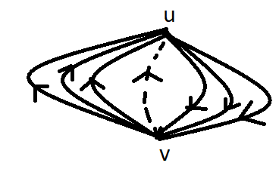
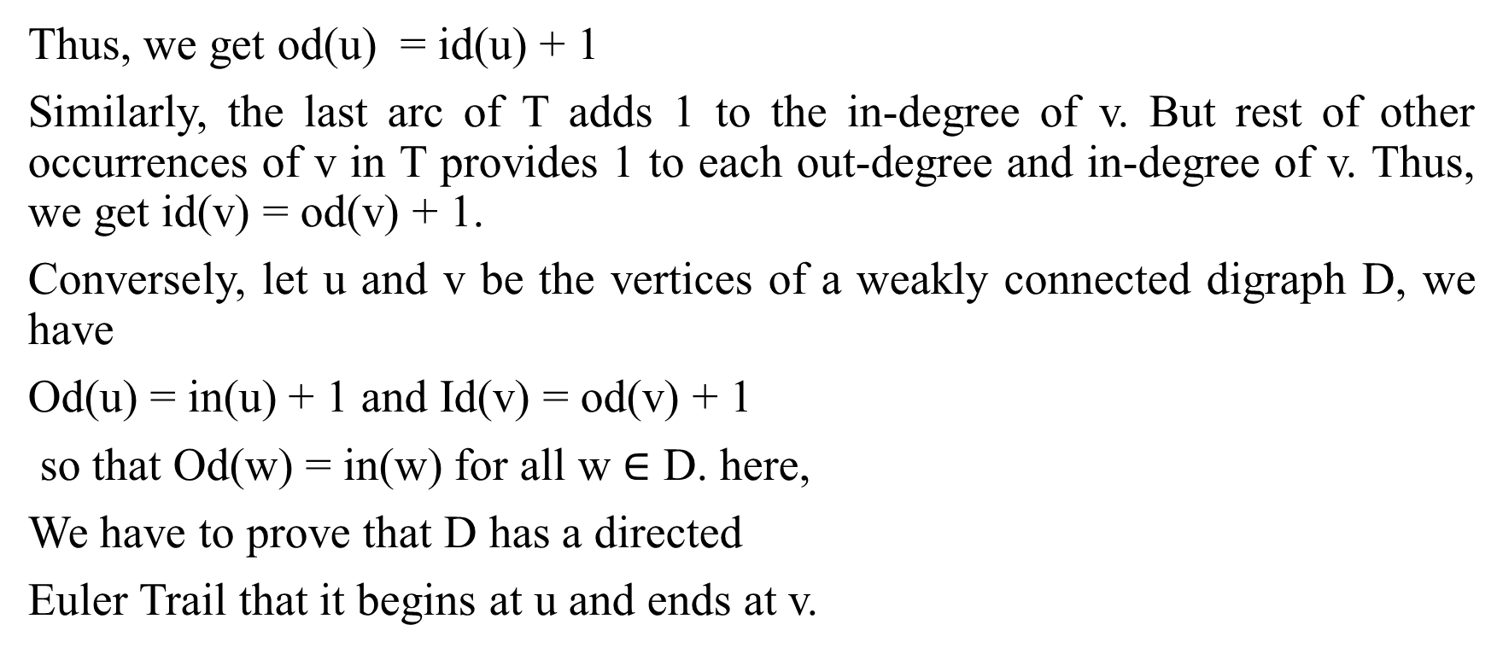
Continued….
Thus, we get od(u) = id(u) + 1
Similarly, the last arc of T adds 1 to the in-degree of v. But rest of other occurrences of v in T provides 1 to each out-degree and in-degree of v. Thus, we get id(v) = od(v) + 1.
Conversely, let u and v be the vertices of a weakly connected digraph D, we have
Od(u) = in(u) + 1 and Id(v) = od(v) + 1
so that Od(w) = in(w) for all w $∈$ D. here,
We have to prove that D has a directed
Euler Trail that it begins at u and ends at v.

Slide 11
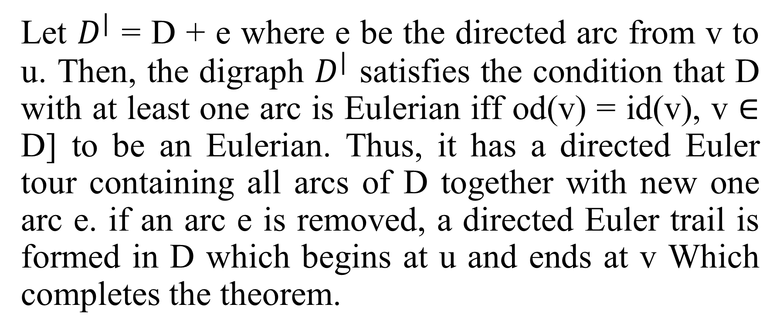
Continued…..
Let $D^{|}$ = D + e where e be the directed arc from v to u. Then, the digraph $D^{|}$ satisfies the condition that D with at least one arc is Eulerian iff od(v) = id(v), v $∈$ D] to be an Eulerian. Thus, it has a directed Euler tour containing all arcs of D together with new one arc e. if an arc e is removed, a directed Euler trail is formed in D which begins at u and ends at v Which completes the theorem.

Slide 12
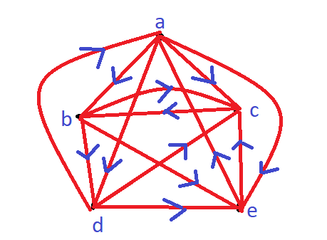
Determine whether the given digraph G is strongly connected, or unilaterally connected or weakly connected?
Solution: Here, G is given digraph.
Now, T(a, b) =(a, b)
T(b, a) = (b, d, a)
T(a, c) = (a, c)
T(c, a) = (c, b, d, a)
T(a, d) = (a, d)
T(d, a) = (d, a)

Slide 13
Connected……
T(a, e) = (a, e)
T(e, a) = (e, a)
T(c, d) = (c, b, d)
T(d, c) = (d, c)
T(c, e) = (c, b, d, e)
T(e, c) = (e, c)
T(b, c) = (b, c)
T(c, b) = (c, b)
T(b, d) = (b, d)
T(d, b) = (d, a, b)
T(b, e) = (b, e)
T(e, b) = (e, a, b)
T(d, e) = (d, e)
T(e, d) = (e, c, b, d)
Therefore, G is strongly connected.

Slide 14
Difference between tree and graph
Tree
It has only one path between two vertices.
It has exactly one root vertex.
No loops are permitted.
It is less complex.
It has n-1 edges (where n is the number of vertices)
Graph
More than one path is allowed.
Graph doesn't have a root vertex.
Graph can have loops.
It is more complex comparatively
Not defined.

Slide 15
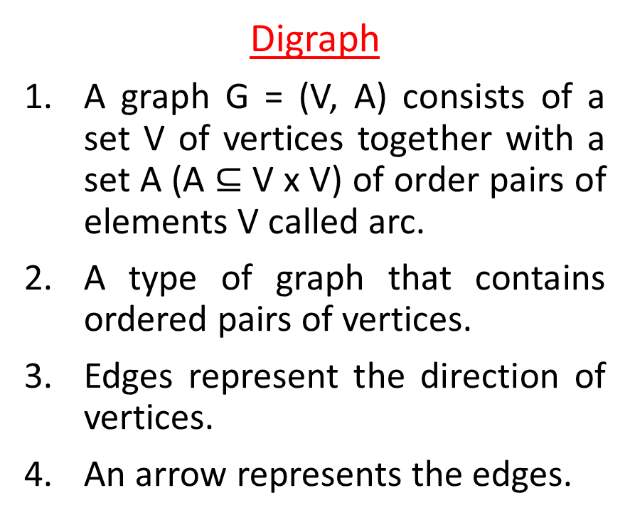
Difference between digraph and graph
Digraph
A graph G = (V, A) consists of a set V of vertices together with a set A (A $⊆$ V x V) of order pairs of elements V called arc.
A type of graph that contains ordered pairs of vertices.
Edges represent the direction of vertices.
An arrow represents the edges.
Graph
A graph G = (V, E) consists of a non-empty finite set of vertex V and a set of edge E.
A type of graph that contains unordered pairs of vertices.
Edges do not represent the direction of vertices.
Undirected arcs represent the edges.

Slide 16


